Slide 1
Biogas Potential of the Inocula Sewage Sludge, Cow Manure, and Fermentation Residues – Investigation of Varying Pre-Treatment and Process Options
Bachelor Thesis
Final Presentation
31st July, 2018
Alexandra Erfort

Slide 2
Outline
Motivation
Objectives
Hypotheses
Methods
Results
Discussion
Conclusion

Slide 3

Motivation
Research in context of the BioRist project
Biogas pilot plant in Vietnam
Inoculum: Cow manure
Search for co-substrates
Data on inoculum required
Extended with sewage sludge and fermentation residues
Motivation - Objectives - Hypotheses - Methods - Results - Discussion - Conclusion

Slide 4





Objectives
Compare gas-formation potential of the inocula
During incubation period of two weeks
Investigate effects of varying pre-treatment and process options
Fresh and stored
Screened and unscreened
Stirred and unstirred
Motivation - Objectives - Hypotheses - Methods - Results - Discussion - Conclusion

Slide 5



Hypotheses
p
Restricted Logistic Activity [1]
Minimal Effect of Storage [2]
Screening Increases Gas Yield [3]
Little Effect of Stirring [4; 5; 6]
t
Motivation - Objectives - Hypotheses - Methods - Results - Discussion - Conclusion

Slide 6
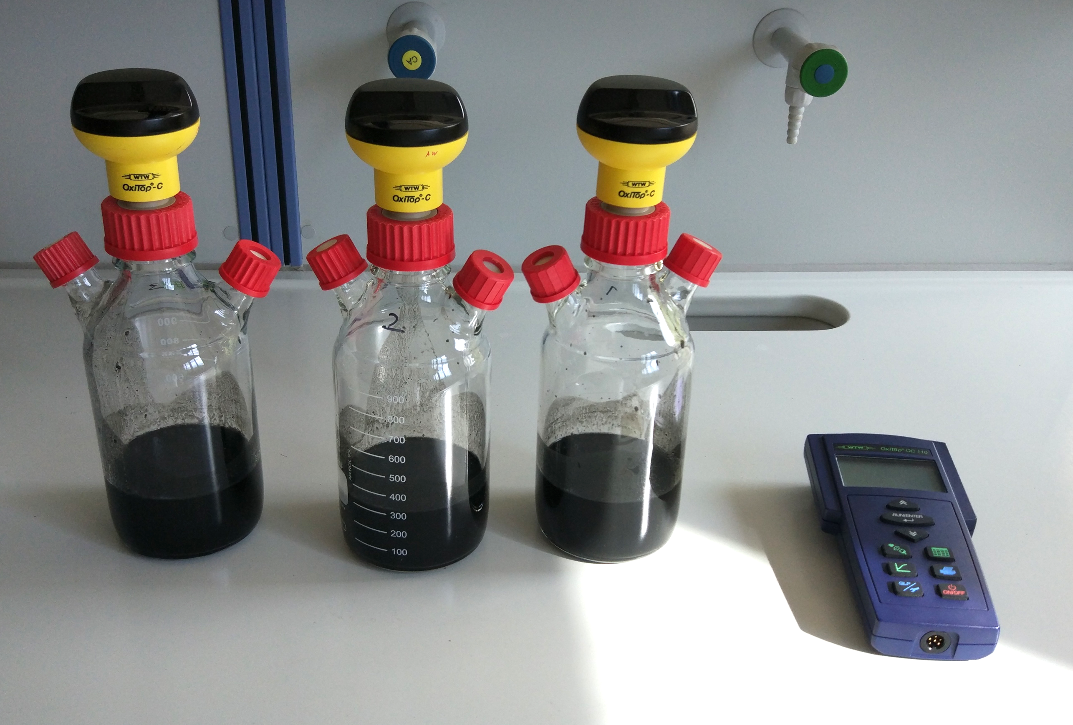
Methods
OxiTop measuring system
Flushed with N₂ for anaerobic environment
Placed in climatic chamber at 37°C
Maximum pressure → manual pressure releases
Analyzed parameters:
Dry substance
Organic dry substance
C/N ratio
Motivation - Objectives - Hypotheses - Methods - Results - Discussion - Conclusion
Notes:
max. 230 hPa increase

Slide 7
Results – Sewage Sludge
Motivation - Objectives - Hypotheses - Methods - Results - Discussion - Conclusion
Notes:
Fast increases correlate with pressure releases → temperature fluctuations
Restricted

Slide 8
Results – Cow Manure
Motivation - Objectives - Hypotheses - Methods - Results - Discussion - Conclusion
Notes:
Restricted and linear; screened extended

Slide 9
Results – Fermentation Residues
Motivation - Objectives - Hypotheses - Methods - Results - Discussion - Conclusion
Notes:
First restricted, then linear, extended

Slide 10
Results – Overall Comparison
Motivation - Objectives - Hypotheses - Methods - Results - Discussion - Conclusion
Notes:
Biogas potential expressed as NL/kg oDS → better comparability
No correlation between oDS degradation and C/N ratios

Slide 11

Discussion
Restricted Logistic Activity
Restricted due to limited resources
Minimal Effect of Storage
High loss of potential during storage
Screening Increases Gas Yield
Smaller particles more accessible for microorganisms
Little Effect of Stirring
Stirring of little amounts not necessary to release gas
Motivation - Objectives - Hypotheses - Methods - Results - Discussion - Conclusion

Slide 12
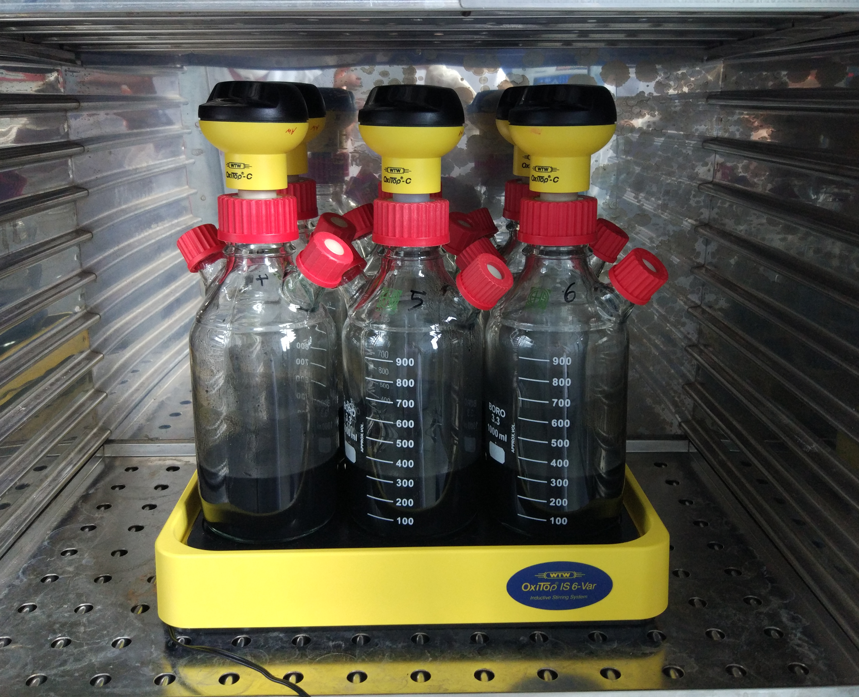
Discussion
Temperature fluctuations cause simulated biogas volume
Continuous stirring and changes in temperature might inhibit microorganisms [7]
Observations of produced volume and organic dry substance and C/N ratios do not show correlations
Motivation - Objectives - Hypotheses - Methods - Results - Discussion - Conclusion

Slide 13

Discussion – Practicability for Vietnam
Laboratory provides different conditions than present on site
No easy storage without sacrificing big percentage of biogas potential
Screening cow manure increases biogas potential significantly
Due to larger scale in biogas plant substrates must be mixed
Motivation - Objectives - Hypotheses - Methods - Results - Discussion - Conclusion

Slide 14

Conclusion
Material should be fresh, have small particles, and be stirred regularly for highest biogas potential.
Further Research Demand:
Correlation between biogas yield and organic substance degradation and C/N ratios
Effects of temperature fluctuations on biogas yield
Motivation - Objectives - Hypotheses - Methods - Results - Discussion - Conclusion

Slide 15
References
[1] | Helmich, U.: Logistisches Wachstum. Helmichs Biologie-Lexikon. 2016. [http://www.u-helmich.de/bio/lexikon/L/logistisches_Wachstum.html], Access: 24.05.2018.
[2] | Browne, J.D.; Gilkinson, S.R.; Frost, J.P.: Biosystems Engineering: The effects of storage time and temperature on biogas production from dairy cow slurry. Vol. 129, Amsterdam: Elsevier, 2014 .
[3] | Mshandete, A.; Björnsson, L.; Kivaisi, A.K.; Rubindamayugi, M.S.T., Mattiasson, B.: Renewable Energy: Effect of particle size on biogas yield from sisal fibre waste. Vol. 31, Amsterdam: Elsevier, 2006.
[4] | Kliche, R.; Lebuhn, M.: Schaum in Biogasanlagen. Biogas Forum Bayern, 2017. [http://www.biogas-forum-bayern.de/media/files/0003/schaum-in-biogasanlagen.pdf], Access: 09.05.2018.
[5] | Schieder, D.; Gronauer, A.; Lebuhn, M.; Bayer, K.; Beck, J.; Hiepp, G.; Binder, S.: Prozessmodell Biogas. Biogas Forum Bayern, 2010. [http://www.biogas-forum-bayern.de/media/files/0001/Prozessmodell-Biogas.pdf] Access: 24.05.2018.

Slide 16
References
[6] | Klußmann, H.: Pump- und Rührtechnik in landwirtschaftlichen Biogasanlagen. n.s. [http://www.bfl-online.de/media/pump_und_%20ruehrtechnik_in_%20biogasanlagen.pdf], Access: 09.05.2018.
[7] | Spahr, M.: Personal communication. Herbst Umwelttechnik GmbH, 27.06.2018.
Image source from slides 3, 4, 5, 11, 13, 14, 17, 18, 20, and 21: flaticon.com

Slide 17

Thank you for your attention!
Any questions?

Slide 18

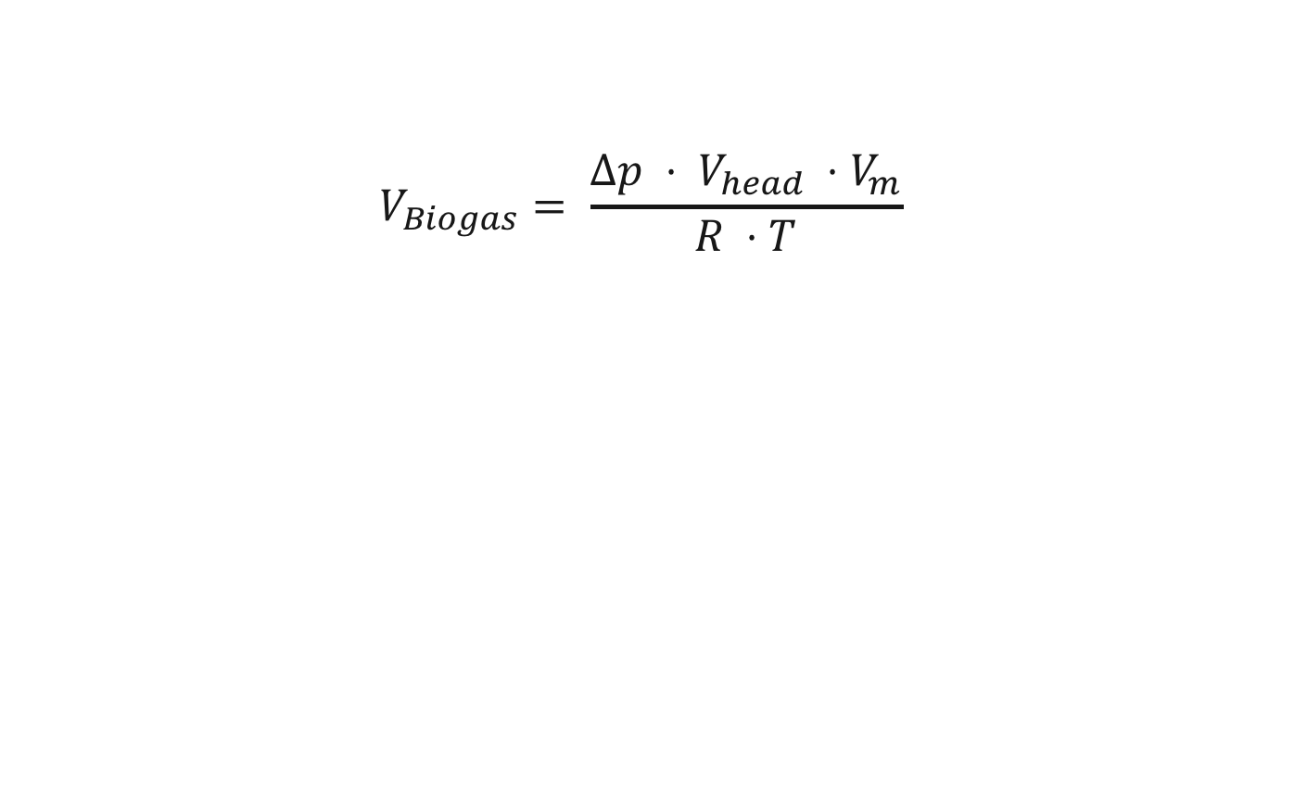
Additional Slides – Volume Calculation
$$V_{Biogas}= \frac{∆p ⋅ V_{head} ⋅V_{m}}{R ⋅T}$$
V_{Biogas} Δp V_{head} V_{m} R T | Biogas volume Absolute pressure difference Volume of the head space Molar volume Universal gas constant Absolute temperature

Slide 19
Additional Slides – Limitations
Magnetic Stirring Table
Limited to only six bottles simultaneously
Space for only two tests, since at least triple determinations should be conducted
Maximum pressure for measuring heads
Manual pressure release necessary

Slide 20
Additional Slides – oDS and C/N Ratios
Inoculum | ΔoDS [%] |  |  | ΔC/N Ratio
 | 1 | 2 | 3 | 1 | 2 | 3
Fresh SS | 4.41 | 4.4 | 4.48 | -0.69
Stored SS | 1.01 | 0.38 | 0.43 | -0.54 | -0.74 | -0.59
Unscreened CM | 2.66 | 3.29 | 4.77 | -3.95 | -0.03 | -0.07
Screened CM | 3.69 | 2.42 | 2.35 | -1.13 | -2.12 | -1.03
Stirred FS | 4.62 | 4.24 | 4.69 | -1.68 | -1.65 | -1.4
Unstirred FS | 3.89 | 2.28 | 2.81 | 0.49 | 0.4 | 0.59
Biogas Yield (NL):
High
Medium
Low
Notes:
oDS and CN, differences from before and after incubation, since before the values were all the same → no correlation to highest or lowest yield
Unstirred FR only inoculum where C/N increased during incubation

Slide 21
Additional Slides – Corrected Volumes
Notes:
Due to temperature fluctuations big error, on average 8% added through simulated biogas

Slide 22


Additional Slides – Material
OxiTop Measuring Head
Pressure Release
OxiTop Controller
Inoculum
Stirring Flea

Slide 23
Additional Slides – Results
Overall biogas potential after two weeks:
>
>
Fresh
Screened
Stirred
>
>
>
Unstirred
Stored
Unscreened

